Slide 1
JPEG Image Compression Standard(.jpg)
YCbCr
Chroma Subsampling
JPEG ENCODER
.jpg
Raw Image
Aditya Raina (202201466)
Om Lachake (202201017)
Parjanya Rajput (202201115)
Ayushi Jani (202201141)
Harshali Dharmik (202201214)
Pari Chauhan (202201189)

Slide 2
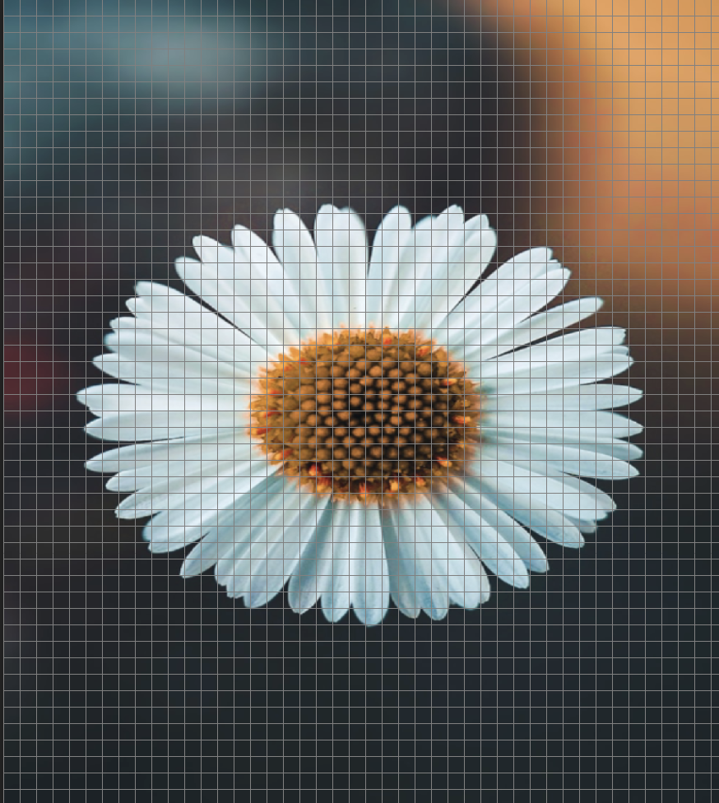
Representation
Of an Image
JPEG - Joint Photographic Expert Group
All images are represented in form of a small pixels as shown in given image (small squares in a grid represents pixels)
Each image have a particular dimensions
Number of pixels in any image = height x width
878
980

Slide 3
How does Computer Represent Images?
Every Pixel stores 3 values namely RGB(Red - Green - Blue)
The values ranges from 0(least bright) - 255(most bright)
Each color/value is represented using 1 byte(8 bits)
So each pixel has 3 values so space occupied by 1 pixel = 3 x 1 = 3 bytes
We can say that the byte to pixel ratio in an image = 3
Calculation of size of an image is done using the formula: Number of pixels x size of one pixel

Slide 4

Beauty of JPEG Compression!
Source: Unsplash
Suppose the given image is of dimension 2560 x 1080 so from the above mentioned
formula the size of the image is around
2560 x 1080 x 3 = 8.3mb approx
From the above chart its clear, that why JPEG is so important
It reduces the size of file drastically, following is the approximation
.jpg file = 5% of size of original file

Slide 5
How JPEG achieves such High Level of Compression?!
JPEG achieves this using series of compression methods.
1. Lossy Compression method
Encoder/
Decoder
.jpg
The job of jpeg is defining how this encoding and decoding work
The value of RGB of uncompressed image is not equal to the value of RGB after the compression
JPEG intentionally losses information to achieve high compression levels
As information is lost during this process it is termed as “Lossy Compression”

Slide 6
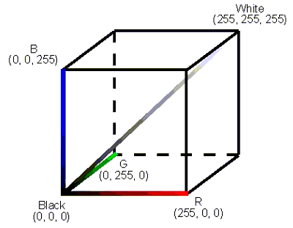
1.1 Lossy Compression
What sorts of information can we get rid of and how??
It is proven that our eyes are much more sensitive to brightness than colour - jpeg can take advantage of this fact
RGB Value plotted in 3D
Upon close observation we can see that if we move along the middle diagonal from 0-255 we get different shades of grey eventually ending up ot brightest one at 255 i.e we can get brightness if we move along this axis
Using this observation and the fact that our eyes are less sensitive to colour, a new colour space has been developed namely “YCbCr”
Source: baslerweb

Slide 7
YCbCr colour space
Y - axis, Cb - Chroma Blue, Cr = Chroma Red
Cb and Cr components encodes the colour while Y part encode the brightness
Advantages of Defining YCbCr colour space
By doing so we have separated the Colour and Luma components from an image
As our eyes are more sensitive to Luma Component we keep it unchanged for now.
Using this colour space just by changing the Luma part we can get the colour that our eyes perceives best.
Being less sensitive to colour we can sample out Cb and Cr components from an image to reduce the size, this sampling of Cb and Cr components from and image is termed as “Chroma Downsampling/Subsampling” .

Slide 8




Image in YCbCr Colour space
Y Component
Cb Component
Cr Component
=

Slide 9
Chroma Downsampling
(4:2:0)
We simply go through the image in 2x2 blocks
Each block has 4 pixel with different colour values
Now take the average of all 4 pixels and make it the as the colour of one 2x2 block
So we reduced 4 pixels to 1 pixel just by averaging the values
One may take the value of top left value as the value of whole pixel
This way averaging plays a key role in compression
*This is only done for Chroma Components
Suppose image is of 8x8

Slide 10


Chroma Downsampling
Downsampling only Chroma Components
Cr Component
Cb Component
After Downsampling
After Downsampling

Slide 11

Beauty of Chroma Downsampling
From previous slide one cannot see major differences in Cb and Cr parts after subsampling
This is due to the fact that our eyes are less sensitive to colour
But by doing so we have drastically reduced the size of an image
 | Y | Cb | Cr
Pixel Count | 64/64 | 16/64 | 16/64
Pixel Ratio | 100% | 25% | 25%
Fraction of image | 1/3 | 1/3 * 1/4 | 1/3 * 1/4
Final Size | 1/3 + 1/12 + 1/12 = 1/2
As from the given table it’s clear that by doing so we have reduced the size of image by 50%
What will happen to the quality of image?
Answer: Next Slide

Slide 12


Compressed Image size = 50% x size of original
No visual difference is seen as such
Source-Unsplash
Convert to YCBCR
Combine Y,CbReduced and CrReduced
Convert to RGB from YCBCR

Slide 13
With the help of Chroma Subsampling we have reduced the size of image by “50%” but still we’re far away from that “5%” compression level.
So what can we do now?
Until now we’ve made heavy changes in Chroma Components.
Let’s see what can we do with Luma(Y) Component.

Slide 14

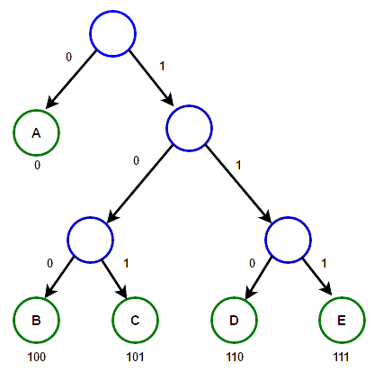
Achieving 5% Compression!
Majorly focused on Y component of YCbCr color space
JPEG Encoder
Forward DCT
Quantisation
Lossless Encoder

Slide 15
Images in Form of Signal
Take a row of pixels from an image and plot their pixel values on a graph with y-axis ranging from 0-255
-> This will give us a approximation of signal
Why do we need to represent images in form of signal?
From real life experiments made it was found that Human Visual System is less sensitive to high frequency detail
For almost every image that is captured is mostly composed of Lower Frequency Detail
JPEG Removes Less Important Higher Frequency components to achieve even more compression
Source-Unsplash

Slide 16
Images in Form of Signal
Visualization of an image as a signal gives us the advantage of using the frequency component
of the Image
255
255
Higher Frequency: Corresponds to Rapid changes between the Pixels
Lower Frequency: Corresponds to Smoother changes between the Pixels
How do we get the Frequency Components of an Image??
—> DCT

Slide 17
Direct Cosine Transform(DCT)
Helps in getting the Frequency Components from an Image
The way that the DCT works is we take some data and we try to represent it as the sum of lots of cosine waves.
It transforms an image from Spatial Domain to Frequency Domain.
It is a type of fast computing Fourier Transform which maps the real signals to the corresponding values in Frequency Domain.
Helps in storing images in compressed format and then reconverted to RGB version for the display purposes.
Moreover it can also be used for transmission of information in compressed format, therefore consuming less Bandwidth.

Slide 18
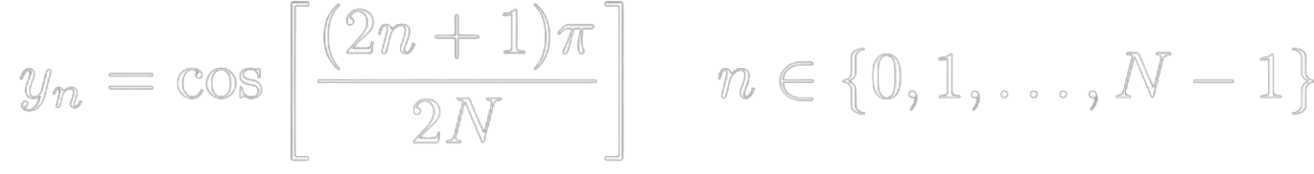
Understanding DCT
Assuming the 8 sample points for simplicity in this example.
We’re only concerned about the discrete sample points.
We’ve just sampled the 8 discrete points by slicing the domain of cosine wave in 8 equal parts, then take mid point of each of these slices.
With these we can get the points needed for DCT process
9∏/16
11∏/16
13∏/16
15∏/16
∏/16
3∏/16
5∏/16
7∏/16
General Equation
y=cos(x)
N=8 for this example

Slide 19
Understanding DCT
Assuming the 8 sample points for simplicity in this example.
We’re only concerned about the discrete sample points.
General Equation
DCT(Y)
N=8 for this example
Only 1 coefficient have a non zero value this means that only 1 cosine wave contributes to our input which is true as we’ve taken an input as y=cos(x)
When the amplitude is changes the weight corresponding to that cosine wave reflects the change.

Slide 20
The 1-D DCT
Start with 8 arbitrary grayscale samples where each bar represents the luma part of a single pixel
Shift the values in a graph by 128
Source: cs.stanford.edu
Source: cs.stanford.edu
By doing so we can decompose this sample values into a set of waveforms of different spatial frequencies
This is where we’re able to separate low and high frequency components

Slide 21
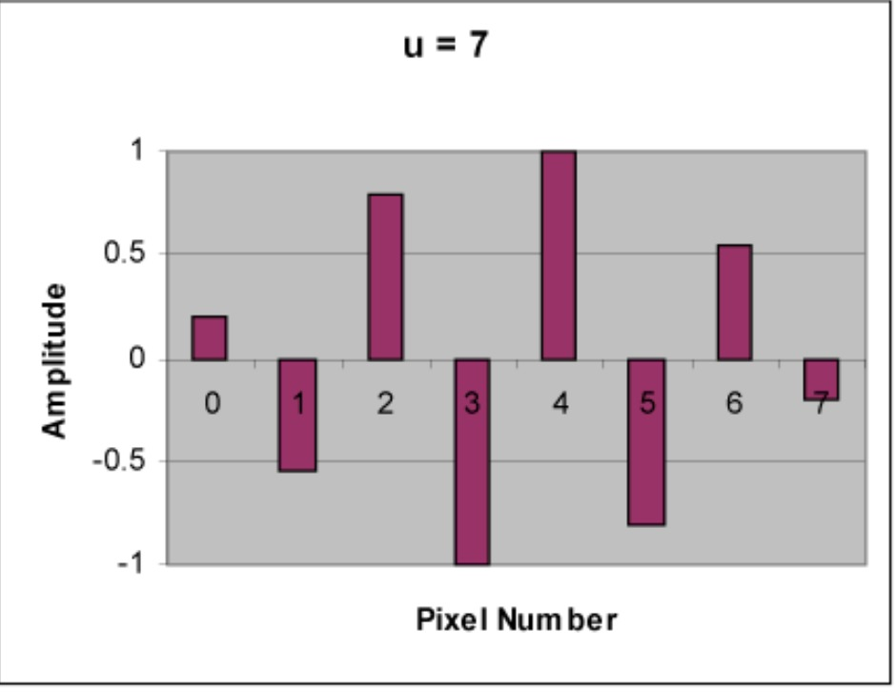
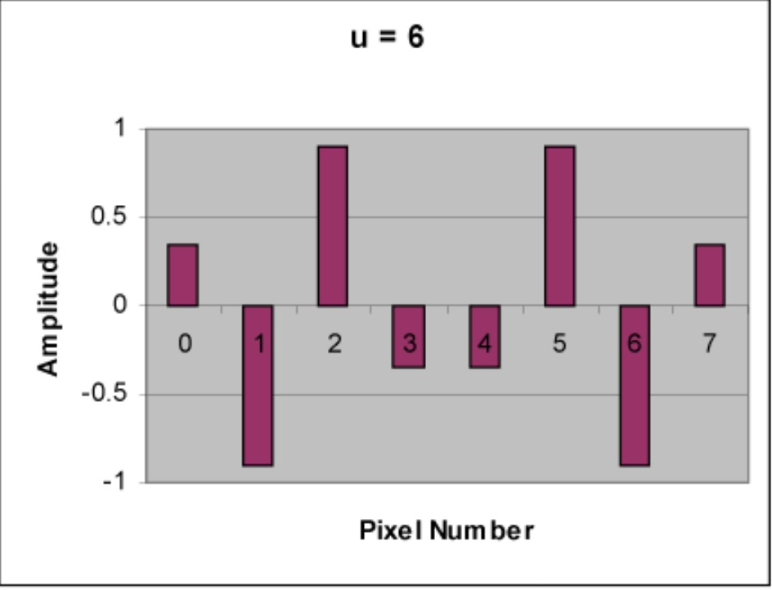
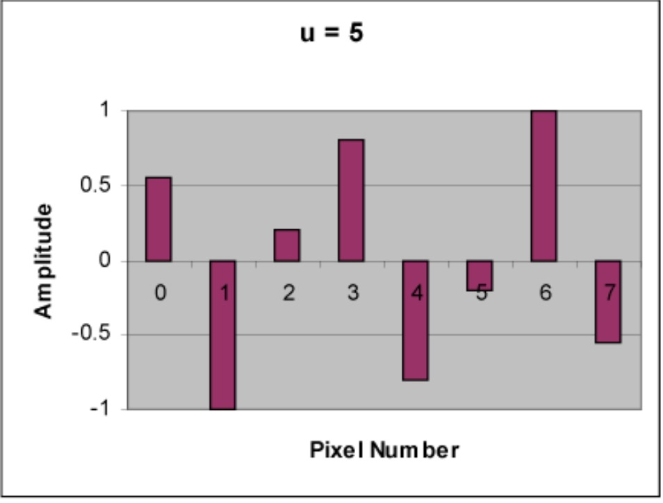
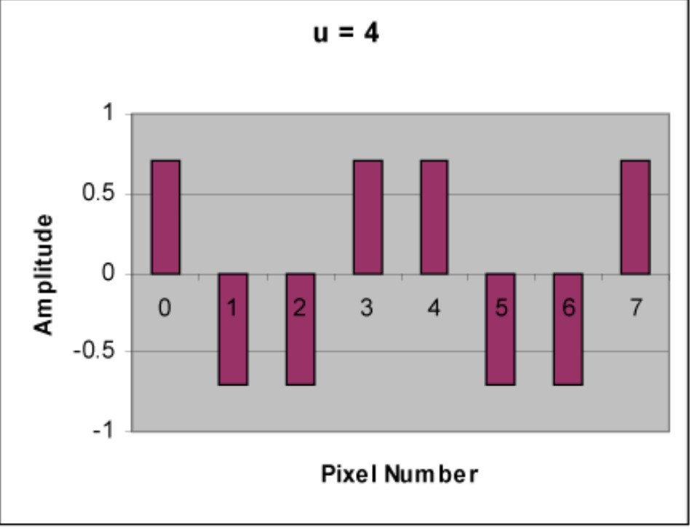
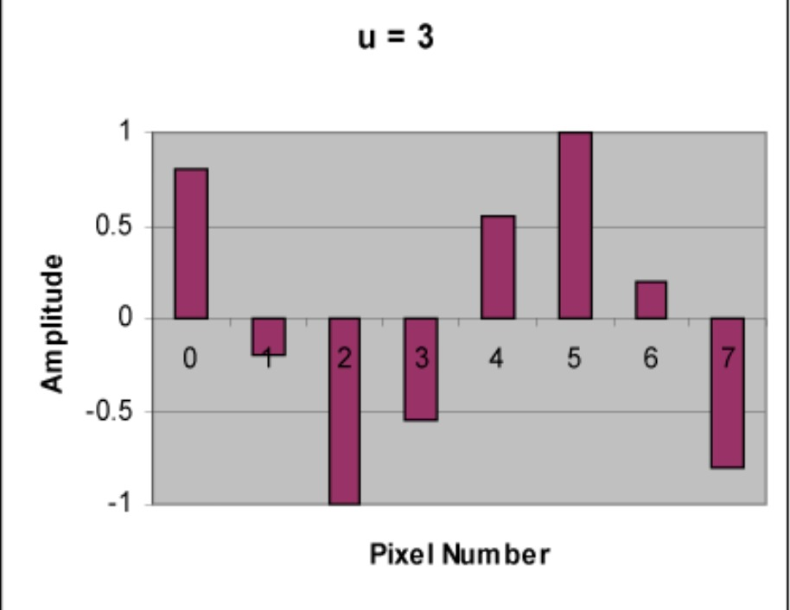
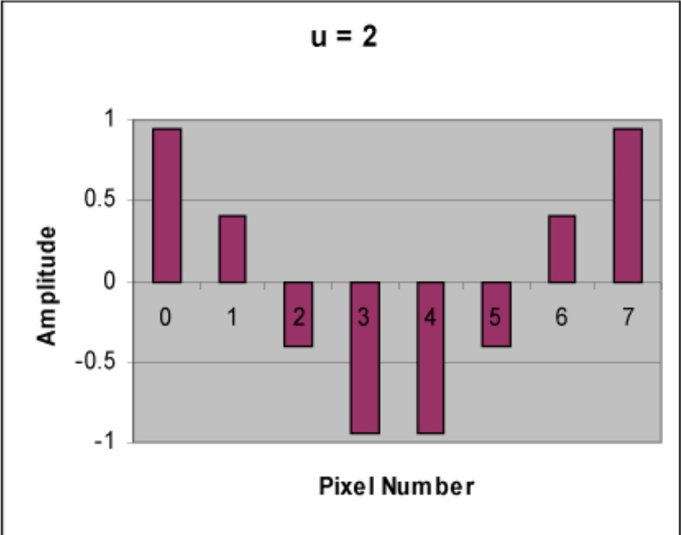
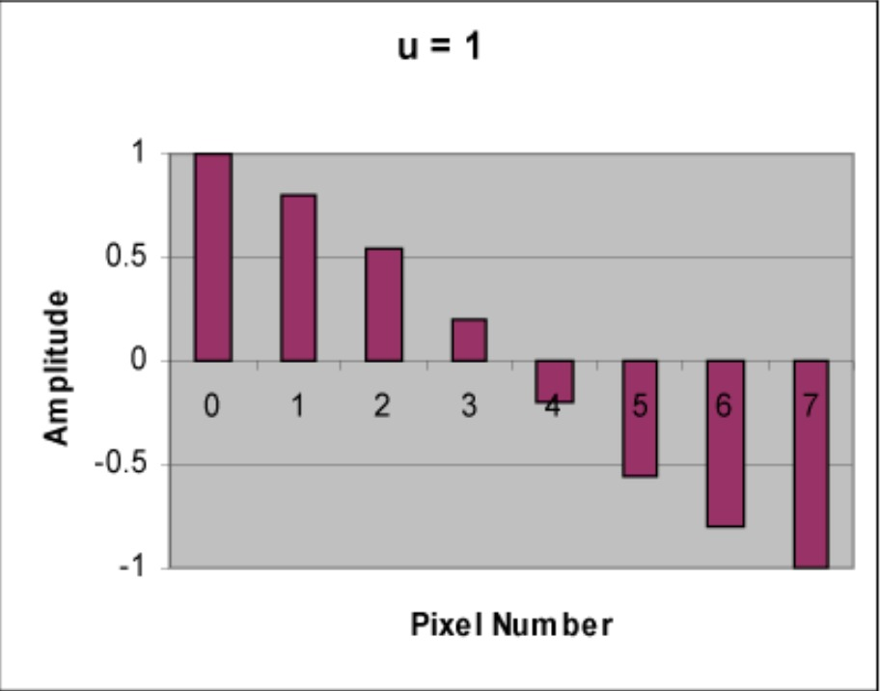
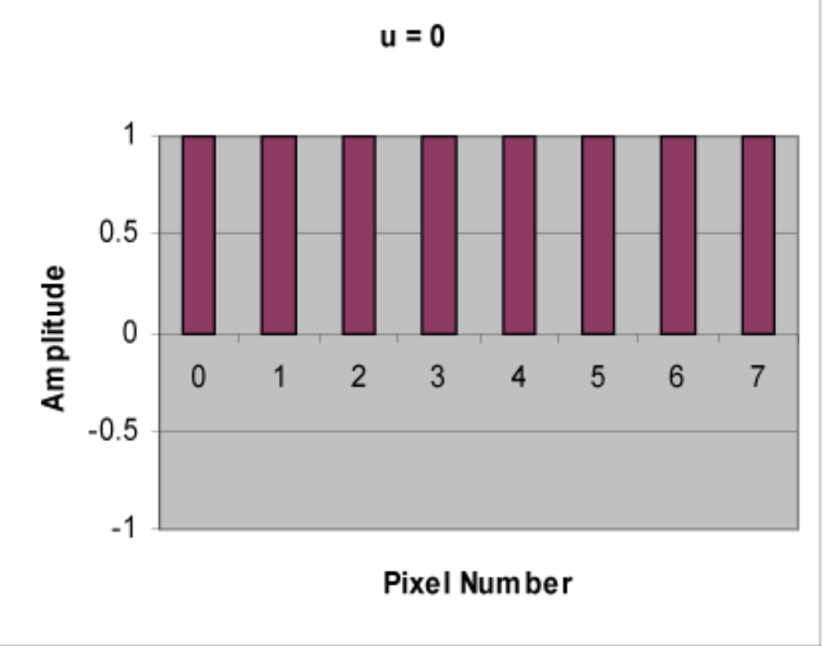
The 1-D DCT
Below is a set of cosine waveforms of 8 different spatial frequencies
The first waveform(u=0) is simply constant whereas other waveforms show alternating behaviour
This waveforms, which are called cosine basis functions are independent, meaning that there is no way a given waveform be represented by any combination of other waveforms
However the set of this waveforms, when scaled by numbers called coefficients and added together can be used to represent any waveform such as the waveform in (b)
Source: cs.stanford.edu

Slide 22
The 1-D DCT
Conclusion
DCT output of (b)
The aim of DCT is to determine the values of these coefficients.
There is a direct correlation between the magnitude of coefficient for a given waveform and its impact on the quality of the picture.
This may not seem useful in 1-D but when its applied in 2-D for an images this concept becomes a key role in deciding what information can be removed to achieve compression.
Source: cs.stanford.edu

Slide 23
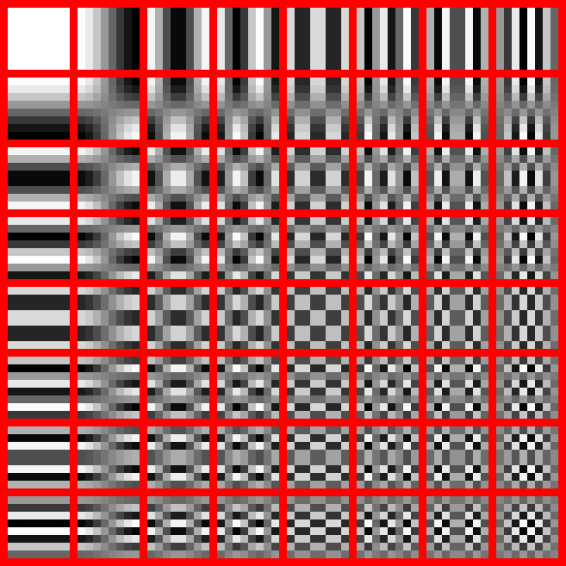
How do DCT Bases Look Like in 2-D
The DCT transforms an 8×8 block of input values to a linear combination of these 64 patterns. The patterns are referred to as the two-dimensional DCT basis functions, and the output values are referred to as transform coefficients.
These patterns are then scaled with coefficients and added to get the desired pattern in an image
Source:https://dsp.stackexchange.com/

Slide 24
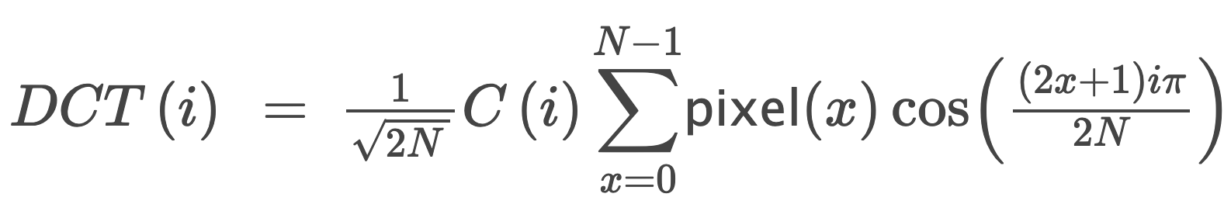
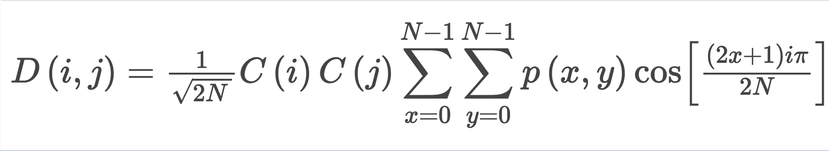
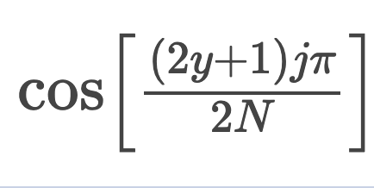
Mathematical Formulation DCT
For JPEG Compression N=8 :)
1-Dimensional DCT
C(u) = 1/√ 2 if u = 0, else 1 if u>0
2-Dimensional DCT
C(u) = 1/√ 2 if u = 0, else 1 if u>0

Slide 25
DCT for JPEG
Application of 2-D DCT
JPEG splits every image into a 8x8 block then centres their values around 0 by subtracting by 128.
Then we apply DCT to each row of these 8x8 blocks, resulting in 8 sets of DCT Coefficients.
Now the resulting 8x8 matrix from (2) is passed again for “Column wise DCT”, these resulting matrix is the output.
The application of DCT along the Rows and then along the Columns is primarily called as 2-Dimensional DCT.
At last, we have 64 coefficients which are just weights on a specific 8x8 patterns

Slide 26
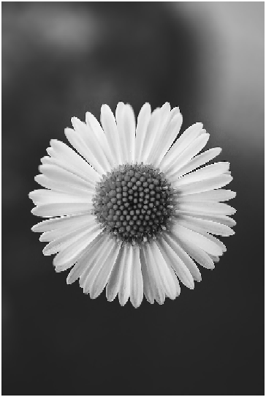
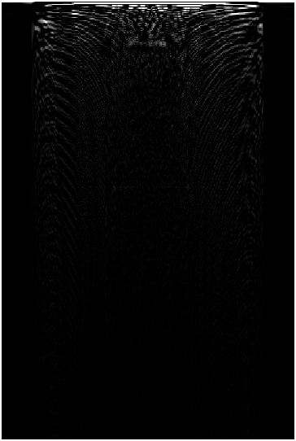

Beauty of DCT
Concept of “Energy Compaction”
RGB Image
GrayScale
1-D DCT
2-D DCT
Source-Unsplash

Slide 27
Beauty of DCT
Concept of “Energy Compaction”
2-D DCT
After applying 2-D DCT, we can see whole image is reduced to an almost black image, but if we observe closely in top left part of the image we’ve got some information saved.
99% of the information required to recreate the image is enclosed within this box.
After applying DCT most of the largest values are concentrated in few low frequency coefficients, this phenomena is called as “Energy Compaction”.
Energy Compaction is a very useful property as it helps in achieving significant data compression while not compromising with image quality.

Slide 28
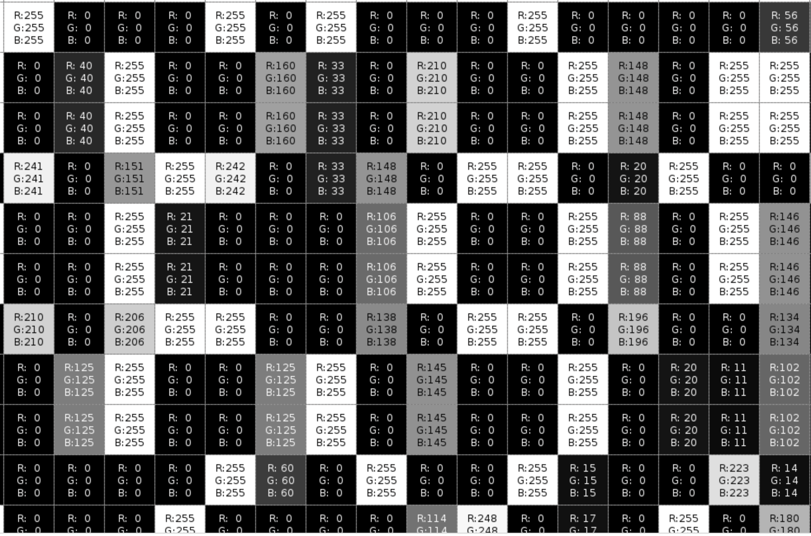
Observation
2-D DCT

Slide 29
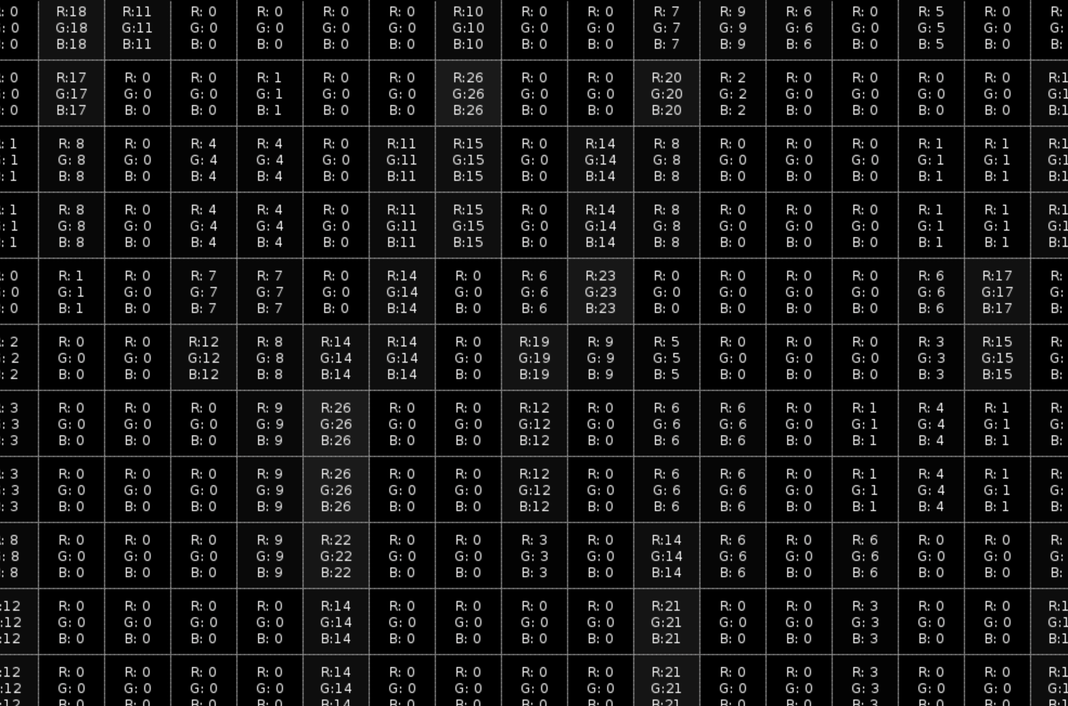
Observation
2-D DCT

Slide 30
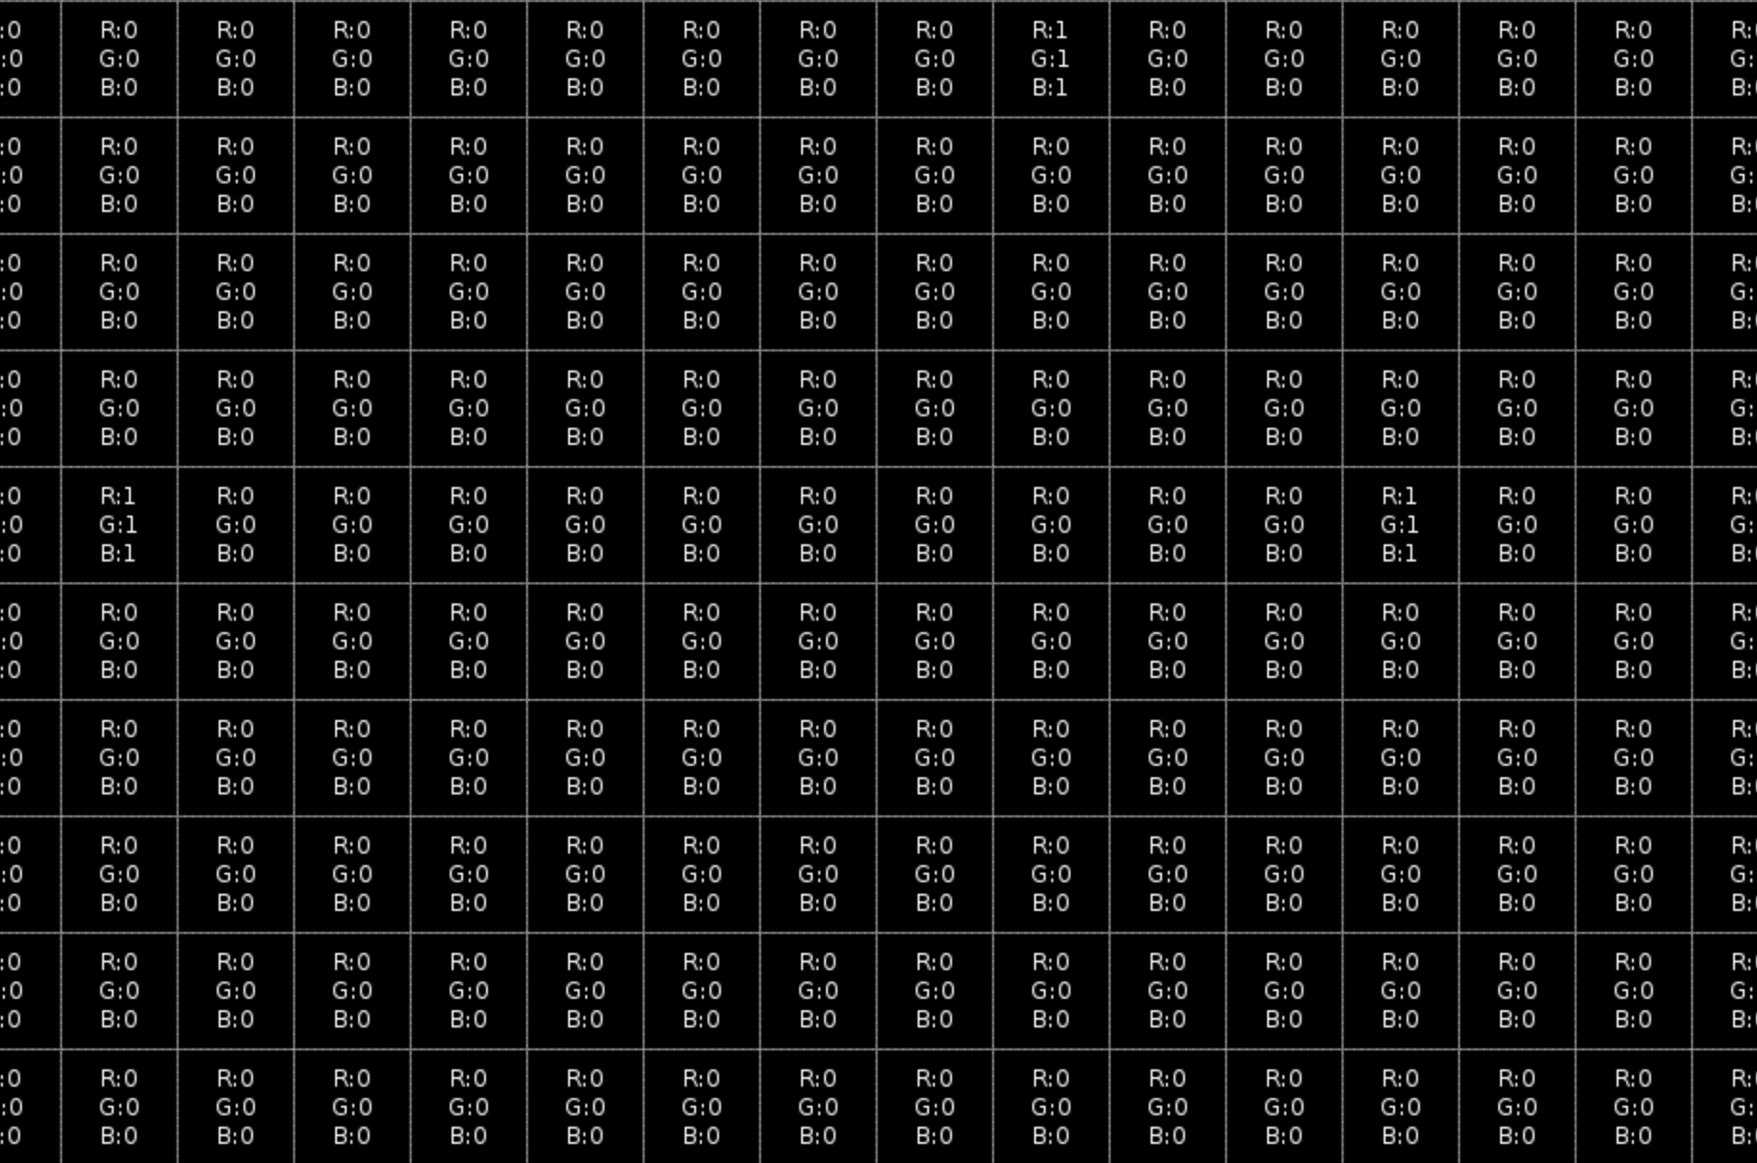
Observation
Most of the information for an image is in top left part.
This means that we can remove less significant higher frequency components.
2-D DCT

Slide 31
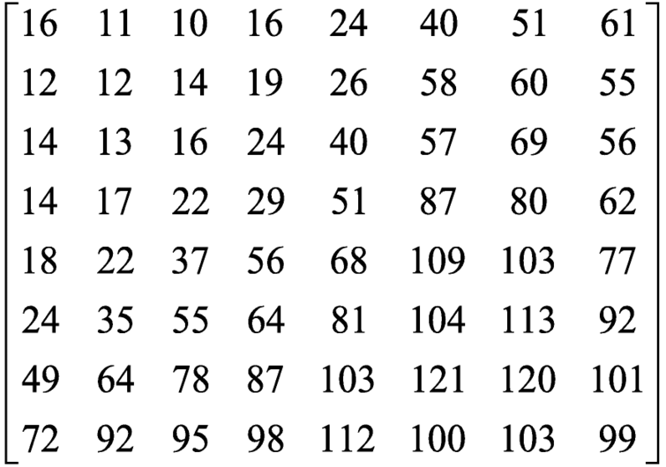
Quantization
Method to remove Higher Frequency Components
JPEG Standard Quantisation Table
Process to reduce number of bits required to store an integer value by reducing the precision
For any given matrix of DCT Coefficients, we can reduce the precision of the coefficients by moving farther away from them. This is because the farther we’re from the the Coefficients, the less the element contributes to the graphical image.
Quantisation matrix differs on the basis of the Quality Factor.
Source:ResearchGate

Slide 32
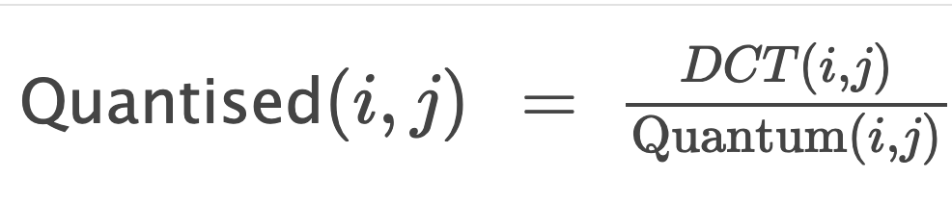
Process of Quantization
Sample Quantisation Matrix(Q1)
3 | 5 | 7 | 9 | 11 | 13 | 15 | 17
5 | 7 | 9 | 11 | 13 | 15 | 17 | 19
7 | 9 | 11 | 13 | 15 | 17 | 19 | 21
9 | 11 | 13 | 15 | 17 | 19 | 21 | 23
11 | 13 | 15 | 17 | 19 | 21 | 23 | 25
13 | 15 | 17 | 19 | 21 | 23 | 25 | 27
15 | 17 | 19 | 21 | 23 | 25 | 27 | 29
17 | 19 | 21 | 23 | 25 | 27 | 29 | 31
For every element position in a DCT Matrix, the corresponding value in the quantisation matrix gives the quantum value indicating the step size for that particular element
The coefficients which are more important are encoded with small step size, while the less important ones are encode with high step size.
Formula for Quantization

Slide 33
Process of Quantization
Encoding
DCT Matrix Before Quantization
92 | 3 | -9 | -7 | 3 | -1 | 0 | 2
-39 | -58 | 12 | 17 | -2 | 2 | 4 | 2
-84 | 62 | 1 | -18 | 3 | 4 | -5 | 5
-52 | -36 | -10 | 14 | -10 | 4 | -2 | 0
-86 | -40 | 49 | -7 | 17 | -6 | -2 | 5
-62 | 65 | -12 | -2 | 3 | -8 | -2 | 0
-17 | 14 | -36 | 17 | -11 | 3 | 3 | -1
-54 | 32 | -9 | -9 | 22 | 0 | 1 | 3
DCT Matrix After Quantization
30 | 0 | -1 | 0 | 0 | 0 | 0 | 0
-7 | -8 | 1 | 1 | 0 | 0 | 0 | 0
-12 | 6 | 0 | -1 | 0 | 0 | 0 | 0
-5 | -3 | 0 | 0 | 0 | 0 | 0 | 0
-7 | -3 | 3 | 0 | 0 | 0 | 0 | 0
-4 | 4 | 0 | 0 | 0 | 0 | 0 | 0
-1 | 0 | -1 | 0 | 0 | 0 | 0 | 0
-3 | 1 | 0 | 0 | 0 | 0 | 0 | 0
Dividing by Q1
Rounded to nearest int

Slide 34
Process of Quantization
Decoding
DCT Matrix After Quantization
30 | 0 | -1 | 0 | 0 | 0 | 0 | 0
-7 | -8 | 1 | 1 | 0 | 0 | 0 | 0
-12 | 6 | 0 | -1 | 0 | 0 | 0 | 0
-5 | -3 | 0 | 0 | 0 | 0 | 0 | 0
-7 | -3 | 3 | 0 | 0 | 0 | 0 | 0
-4 | 4 | 0 | 0 | 0 | 0 | 0 | 0
-1 | 0 | -1 | 0 | 0 | 0 | 0 | 0
-3 | 1 | 0 | 0 | 0 | 0 | 0 | 0
DCT Matrix after Dequantisation
90 | 0 | -7 | 0 | 0 | 0 | 0 | 0
-35 | -56 | 9 | 11 | 0 | 0 | 0 | 0
-84 | 54 | 0 | -13 | 0 | 0 | 0 | 0
-45 | -33 | 0 | 0 | 0 | 0 | 0 | 0
-77 | -39 | 45 | 0 | 0 | 0 | 0 | 0
-52 | 60 | 0 | 0 | 0 | 0 | 0 | 0
-15 | 0 | -19 | 0 | 0 | 0 | 0 | 0
-51 | 19 | 0 | 0 | 0 | 0 | 0 | 0
Multiply by Q1

Slide 35
Quantization
DCT Matrix Before Quantization
92 | 3 | -9 | -7 | 3 | -1 | 0 | 2
-39 | -58 | 12 | 17 | -2 | 2 | 4 | 2
-84 | 62 | 1 | -18 | 3 | 4 | -5 | 5
-52 | -36 | -10 | 14 | -10 | 4 | -2 | 0
-86 | -40 | 49 | -7 | 17 | -6 | -2 | 5
-62 | 65 | -12 | -2 | 3 | -8 | -2 | 0
-17 | 14 | -36 | 17 | -11 | 3 | 3 | -1
-54 | 32 | -9 | -9 | 22 | 0 | 1 | 3
The quantization/dequantization cycle has readily apparent effects. The low-frequency elements near the DC coefficient have been modified, but only by small amounts.
The high-frequency areas of the matrix have, for the most part, been reduced to zero, eliminating their effect on the decompressed image. In this sense, insignificant data has been discarded and the image information has been compressed.
Different Quantization tables are used for Chroma components
DCT Matrix after Dequantization
90 | 0 | -7 | 0 | 0 | 0 | 0 | 0
-35 | -56 | 9 | 11 | 0 | 0 | 0 | 0
-84 | 54 | 0 | -13 | 0 | 0 | 0 | 0
-45 | -33 | 0 | 0 | 0 | 0 | 0 | 0
-77 | -39 | 45 | 0 | 0 | 0 | 0 | 0
-52 | 60 | 0 | 0 | 0 | 0 | 0 | 0
-15 | 0 | -19 | 0 | 0 | 0 | 0 | 0
-51 | 19 | 0 | 0 | 0 | 0 | 0 | 0

Slide 36
Lossless Encoding
Compression of Quantized DCT Values done in 3 steps
Convert the DCT Coefficient to a Relative Value: The DC coefficient is converted to a relative value by subtracting it from the DC coefficient of the previous 8x8 block. This exploits the correlation between adjacent blocks, resulting in a small number requiring fewer bits for storage.
Reorder the DCT in zig-zag sequence: To enhance compression with Run-Length Encoding (RLE) in JPEG, the DCT block coefficients are rearranged in a zig-zag pattern. This prioritizes higher-value elements, maximizing the effectiveness of RLE compression.
Entropy Encoding: The JPEG algorithm utilizes an entropy encoding mechanism that combines RLE and Huffman encoding. It produces a sequence of three tokens (run length, bit count, and amplitude) repeated until the entire block is encoded.

Slide 37

Run-Length Encoding
Storing the DCT Coefficients in Zig-Zag Sequence
Why zig-zag sequence? By doing so we’re able to group maximum number of zeros in a matrix
{90 0 -35 -84 -56 -7 0 0 54 -45 -77 -33 0 11 0 0 0 -13 0 -39 -52 -15 60 45 0 0 0 0 0 0 0 0 0 0 0 -51 19 -19 0 0 0 0 0 0 0 0 0 0 0 0 0 0 0 0 0 0 0 0 0 0 0 0 0 0 }
{90, 0, -35, -84, -56, -7, 0[x2], 54, -45, -77, -33, 0, 11, 0[x3], -13, 0, -39, -52, -15, 60, 45, 0[x10], -51, 19, -19, 0[x26]}

Slide 38
Run-Length Encoding
DCT Matrix after Dequantisation
90 | 0 | -7 | 0 | 0 | 0 | 0 | 0
-35 | -56 | 9 | 11 | 0 | 0 | 0 | 0
-84 | 54 | 0 | -13 | 0 | 0 | 0 | 0
-45 | -33 | 0 | 0 | 0 | 0 | 0 | 0
-77 | -39 | 45 | 0 | 0 | 0 | 0 | 0
-52 | 60 | 0 | 0 | 0 | 0 | 0 | 0
-15 | 0 | -19 | 0 | 0 | 0 | 0 | 0
-51 | 19 | 0 | 0 | 0 | 0 | 0 | 0
JPEG Specific RLE
[(r, s), c]
r-number of zeros preceding value
s-number of bits needed to encode the value c
c-coefficient value
(0,0) indicate end of block
{[(0,7),90], [(1,6),-35], [(0,7),-84], [(0,6),-56], [(0,3),-7], [(2,6),54], [(0,6),-45], [(0,7),-77], [(0,6),-33], [(1,4),11], [(3,4),-13], [(1,6),-39], [(0,6),-52], [(0,4),-15], [(0,6),60], [(0,6),45], [(10,6),-51], [(0,5),19], [(0,5),-19], [(0,0)]}
{90, 0, -35, -84, -56, -7, 0[x2], 54, -45, -77, -33, 0, 11, 0[x3], -13, 0, -39, -52, -15, 60, 45, 0[x10], -51, 19, -19, 0[x26]}

Slide 39
Huffman Coding
Entropy-Based Lossless Compression Algorithm
Input: a set of non-zero quantized DCT coefficients from all the different blocks of the image (for eg. values lying between - 1024 to +1024)
Output: a set of encoded coefficients with length (in terms of number of bits) less than that of the original set.
• Principles behind Huffman encoding:
Encode the more frequently occurring coefficients with fewer bits. Encode the rarely occurring coefficients with more bits. This will reduce the average bit-length
Ensure that the encoding for no coefficient is a strict prefix of the encoding of any other coefficient. This is called a “prefix-free code”.

Slide 40
Huffman Coding
Algorithm
Sort symbols in increasing order of frequency. Create a leaf node from each symbols. These leaf nodes will belong to a binary tree called the Huffman tree.
Combine the two lowest frequency nodes s1 and s2 to create a parent node s12. s1 and s2 will be the left and right child of s12. The frequency of s12 is given by p(s12) = p(s1 ) + p(s2 ).
Label the edge from s12 to s1 with a ‘0’ and the edge from s12 to s2 with a ‘1’
Delete s1 and s2 from the sorted list of alphabets and insert the node s12, i.e. root node of the tree (s12,s1 ,s2 ) in the correct place depending on the value of p(s12).
Repeat steps 2 to 4 until there is only one node in the list. This will be the root node of the final Huffman tree.
Traverse the tree from the root node until each leaf and collect all the binary symbols along every edge into a string. This string will form the code word for that symbol

Slide 41
Huffman Coding for JPEG
Quite Complicated, Why?
We need to Encode the following things:
Signs of Coefficients
Triplets of all 8x8 blocks
DC Coefficients separately encoded from AC
We need to apply this on both Luma and Chroma Components
We also need to deal with different Chroma Subsampling
This presentation doesn’t go into the implementation of Huffman Coding for JPEG

Slide 42
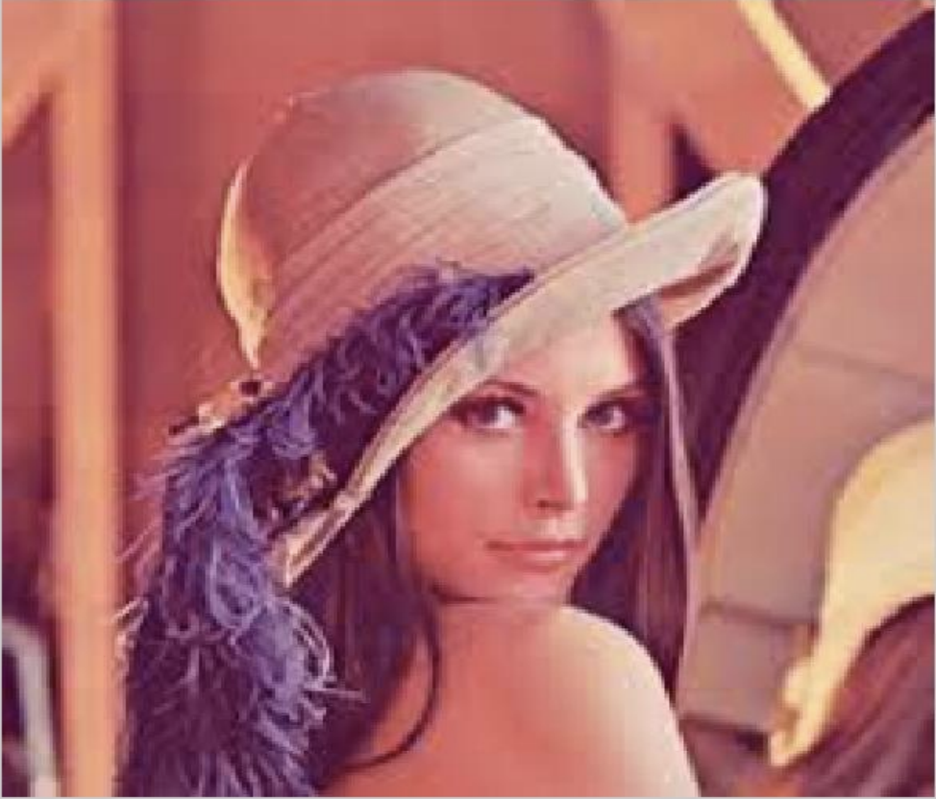
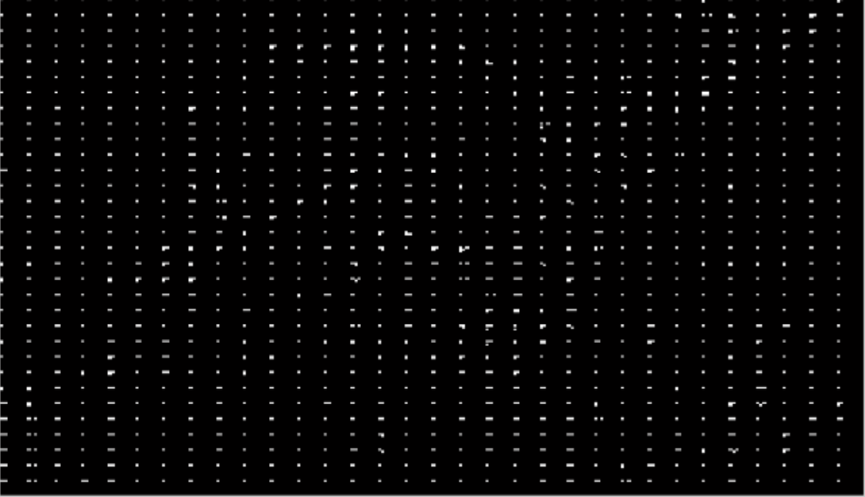
Output of Huffman Coding
Original Image
Compressed Image
Source:https://ijisrt.com/jpeg-image-compression
Source:https://ijisrt.com/jpeg-image-compression

Slide 43
In a Nutshell
Raw Image
(RGB)
Image
(YCbCr)
Chroma
DownSampling
Transform
Entropy Encoding
Quantization
Forward DCT
JPEG Encoded Image
Inverse DCT
Dequantization
Entropy Decoding
Compressed Image
(YCbCr)
JPEG
Compressed Image
(RGB)

Slide 44
JPEG2000 (extension jp2) is the latest series of standards from the JPEG committee.

Slide 45
Thank You
JPEG Committee was established in 1986, while the Compression Standard was Patent in 1992
References in Documentation

